Slide 1
Robotic Arm
Valeriya Khan Dias Issa
Nurbolat Sagitzhan Raiymbek Mustazhapov

Slide 2
Idea
Original idea to combine sensors, servo motors and hydraulic arm
Using medical syringes as a hydraulic medium construct light-weight arm
Syringes are expanded/contracted by motors
Motors are controlled by sensors
Affordable design

Slide 3
Used Materials
4 Servo Motors
8 Medical 10ml Syringes
1 Arduino Uno board
5 Flex Sensors
Cardboard
Water
Glue, Toothpicks and other materials

Slide 4
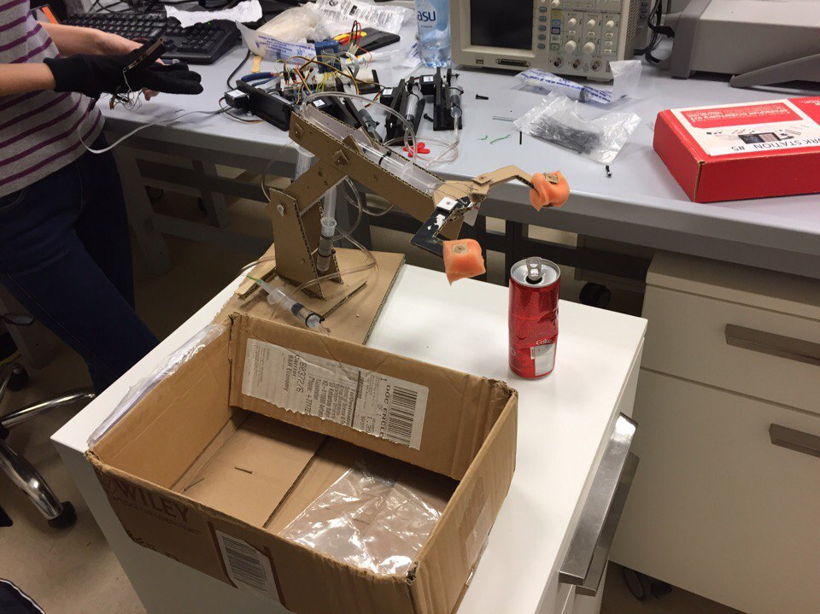
Implementation: Cardboard
Cardboard Arm
4 dynamic parts
Foundation - rotation of whole arm (approx. 75)
Lower Bone – up/down moves
Upper Bone – up/down moves of gripper
Gripper – catch/release objects

Slide 5
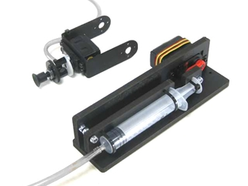
Implementation: Hydraulics
Lynxmotion Vacuum Gripper Kit
4 syringes to control 4 dynamic parts
4 servo motors
Conversion of rotational move to linear move

Slide 6
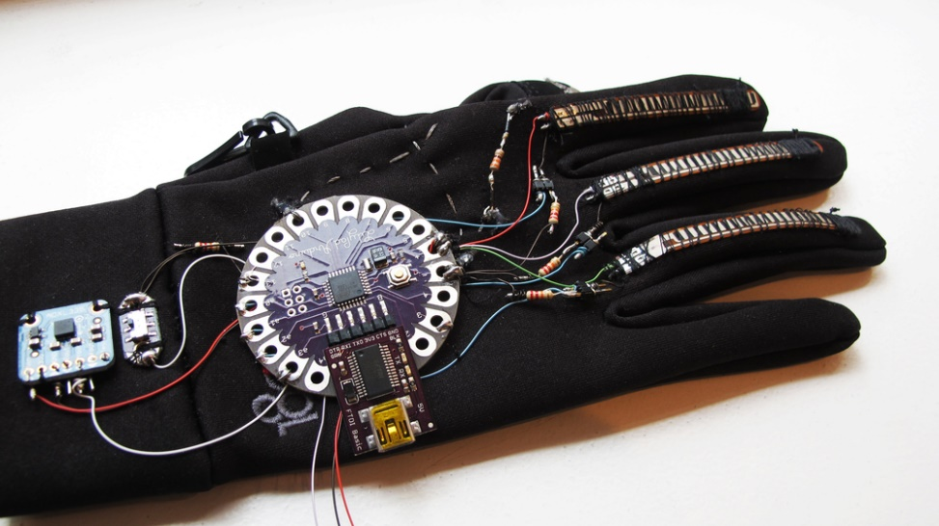
Implementation: Circuits
Arduino Uno Board
Analog Inputs for Flex Sensors
Digital Pins for Servo Control
5 flex sensors
8 states:
Combination of 1 sensor with other 4

Slide 7

Implementation: Code
Arduino’s servo.h library used
Calibration Part
First 100 values read
Average working value of sensors
Implementation Part
Every 100th average read to avoid bouncing

Slide 8
Difficulties
Power: not enough
Sensor values: as always holy mess
Coding challenge: choosing method, concurrency
Design and assembly: symmetry and calibration of positions (syringes)

Slide 9
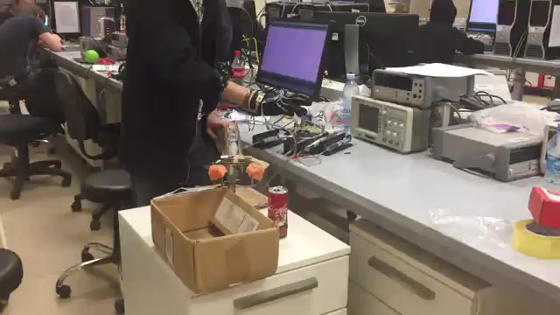
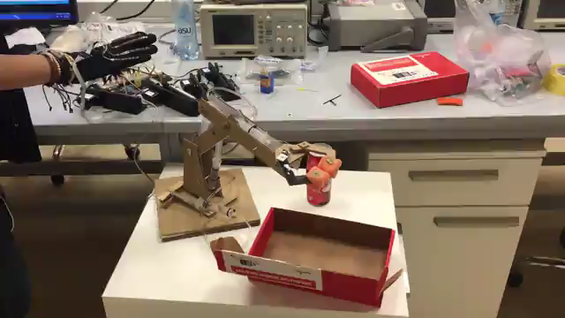
Results
Video 1
Video 2

Slide 10
Thanks for attention!

Slide 11
Reference
http://www.lynxmotion.com/p-825-vacuum-gripper-kit-with-wrist-rotate.aspx
https://www.youtube.com/watch?v=P2r9U4wkjcc&t=285s

